Slide 1

Designing
Experiences.
Engineering
Outcomes.

Slide 2
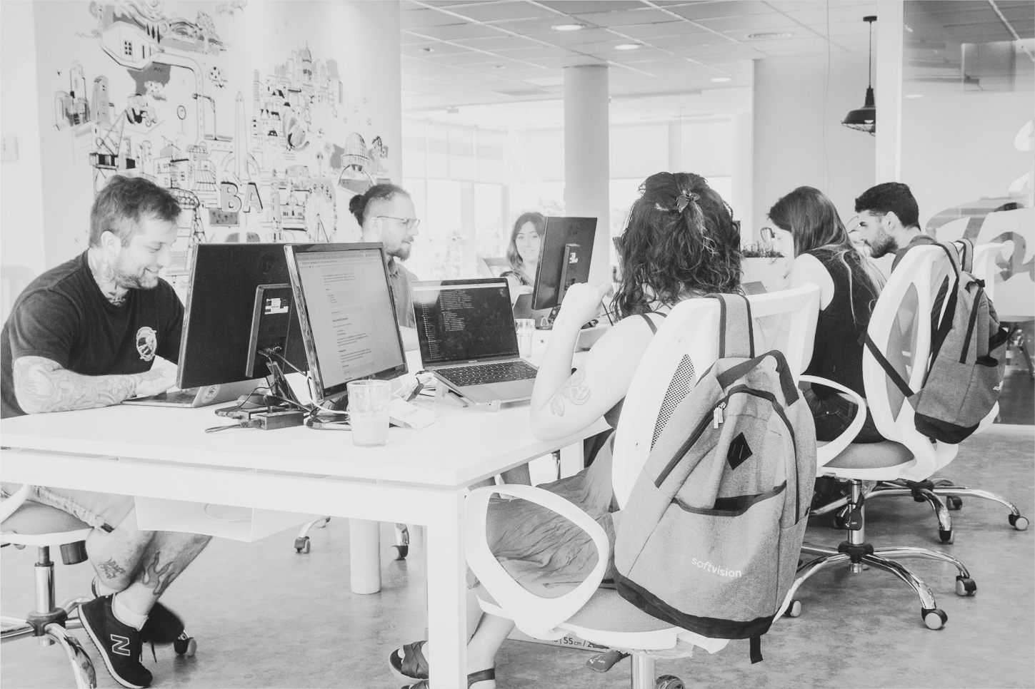
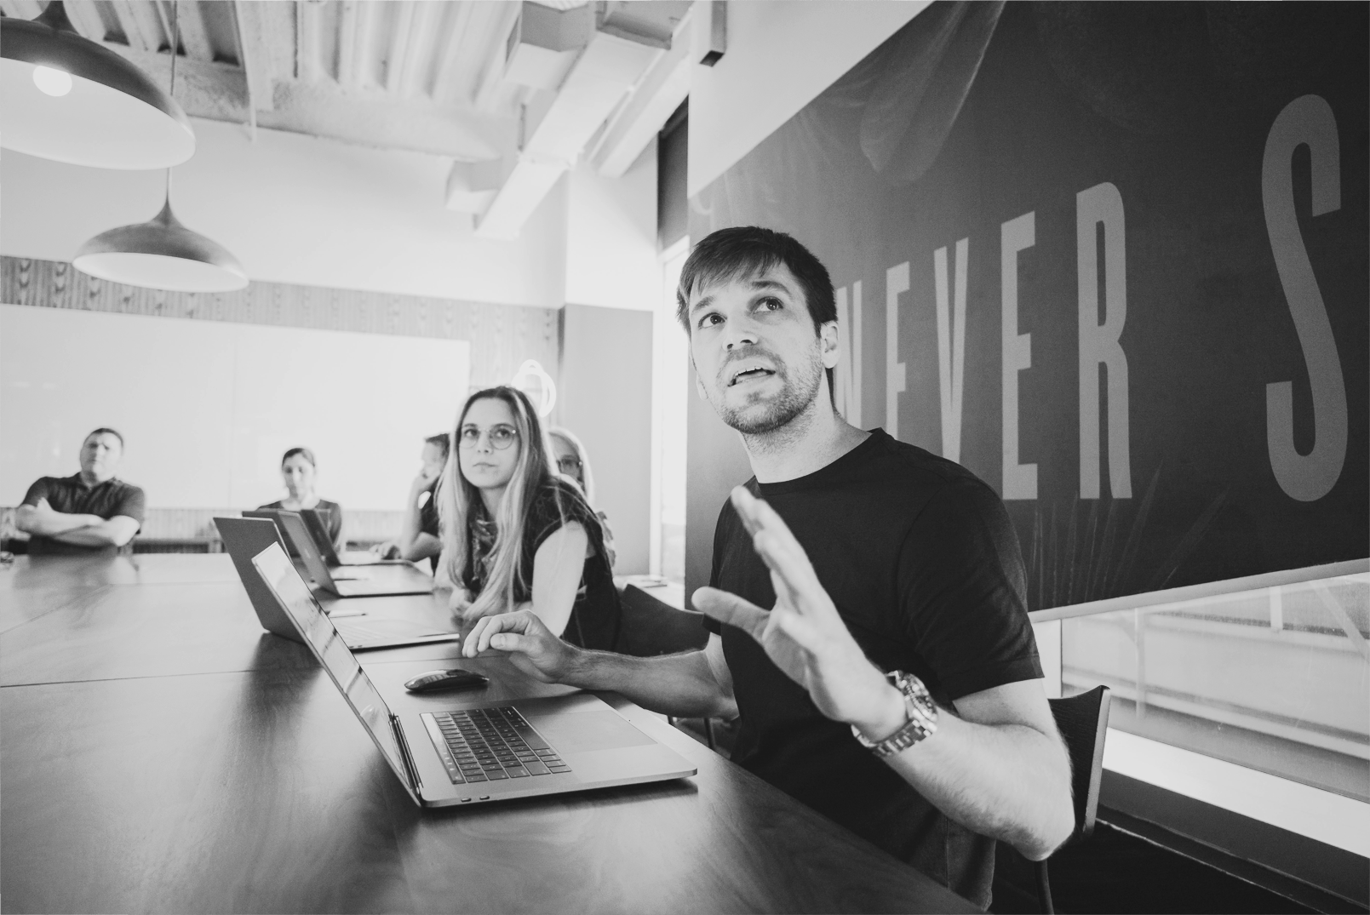

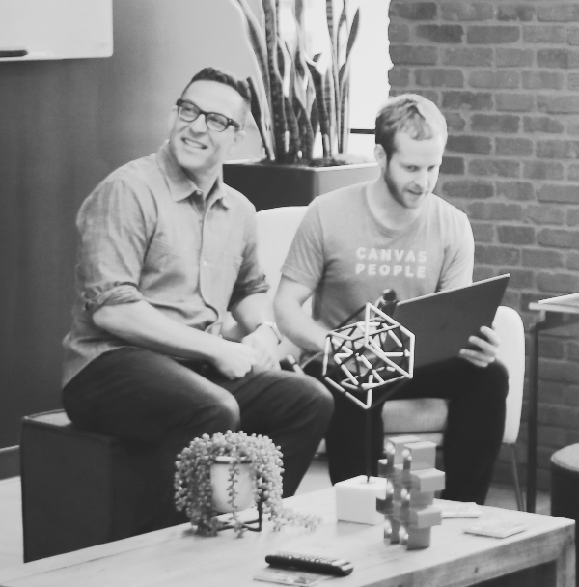

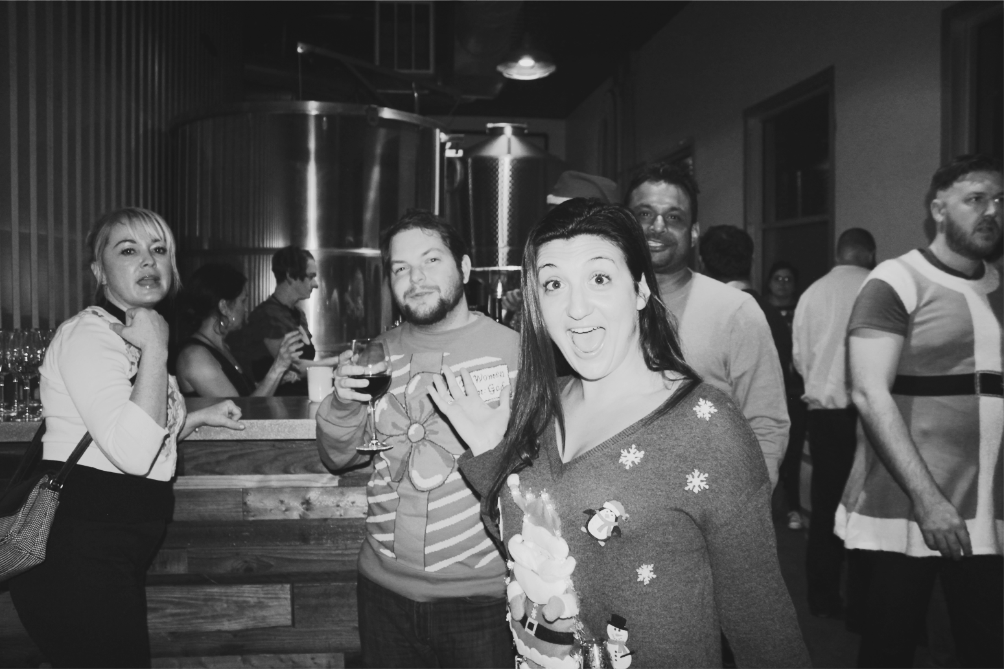

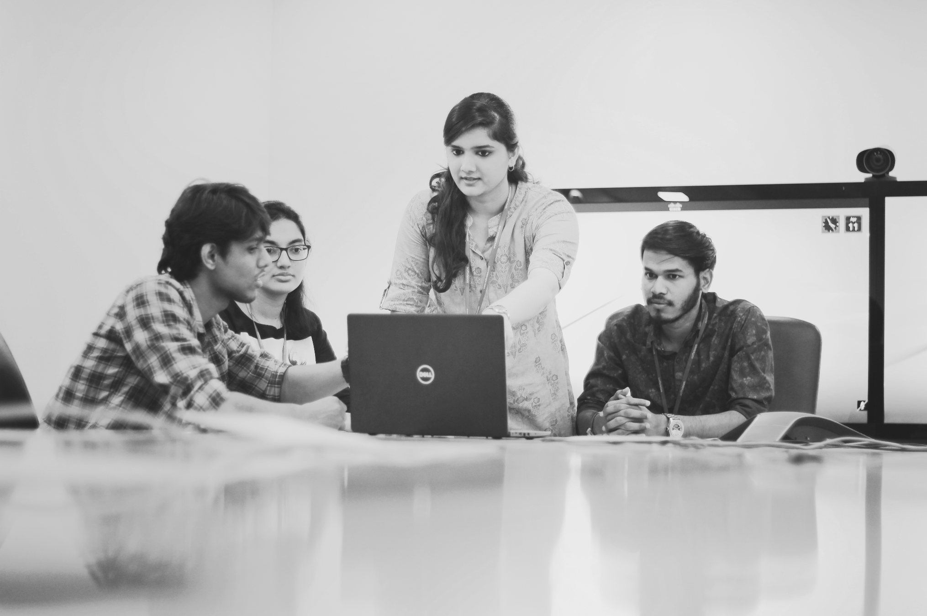


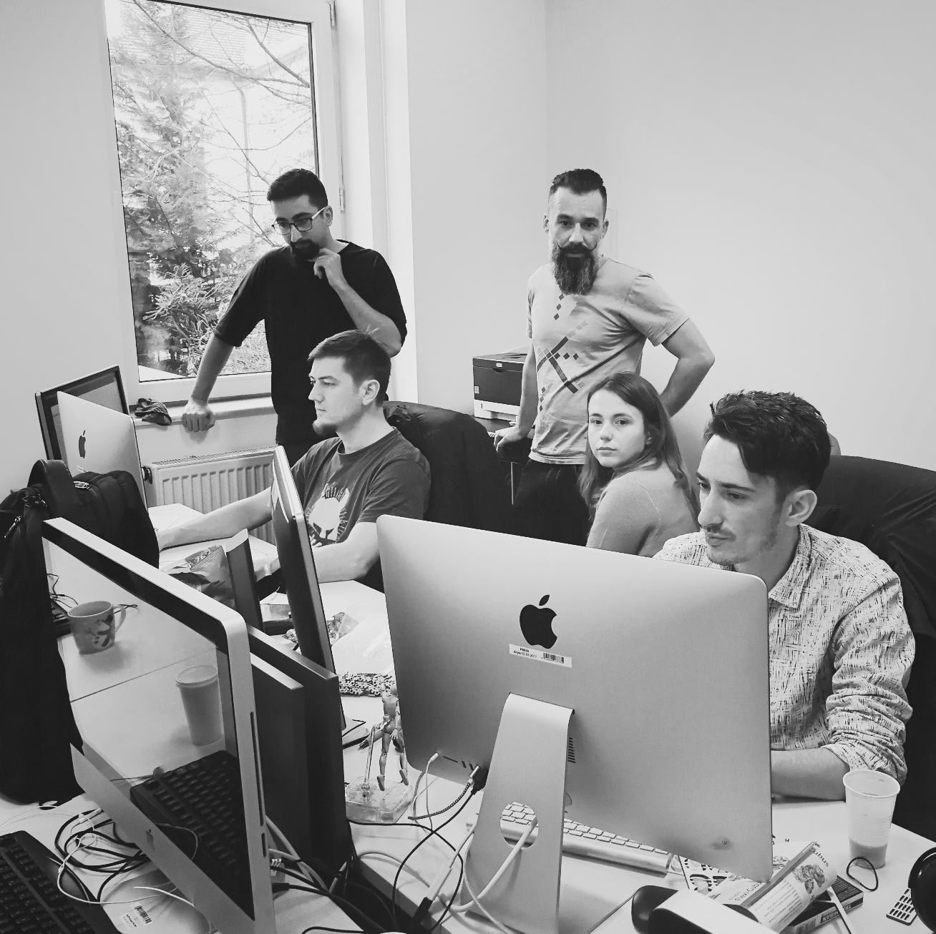
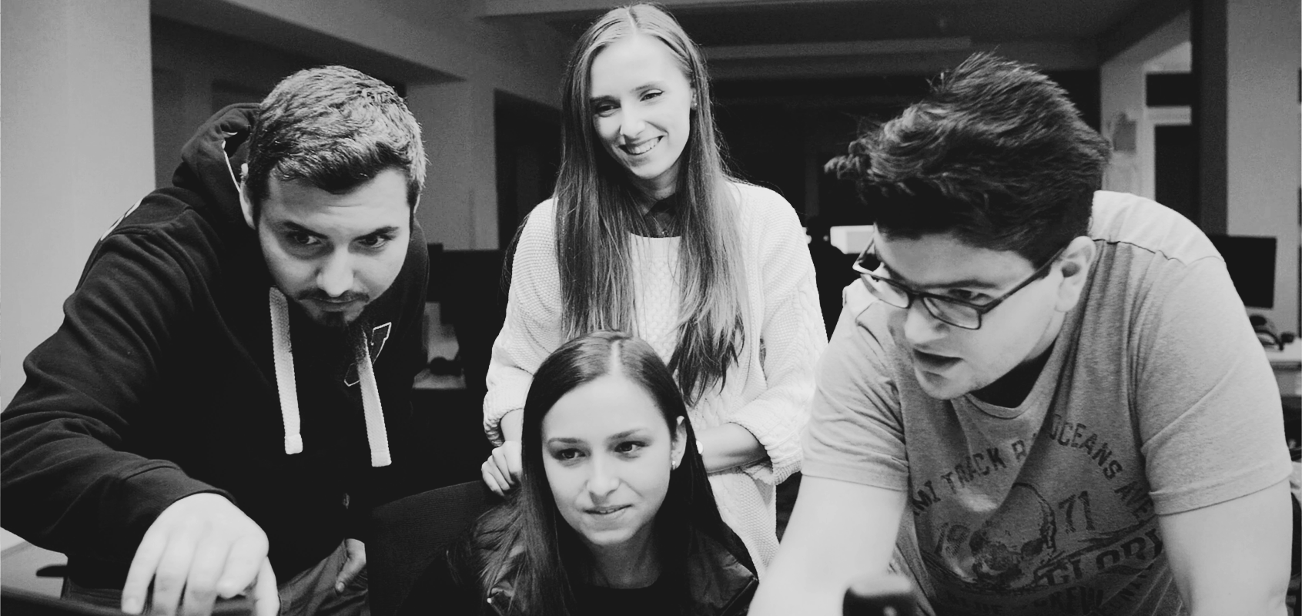
AGENDA
About Cognizant
Our Footprint in the Restaurant Space
McDonald’s & Cognizant
Key Areas of Focus
Client Stories - Proof Points
Appendix

Slide 3
About Us

Slide 4
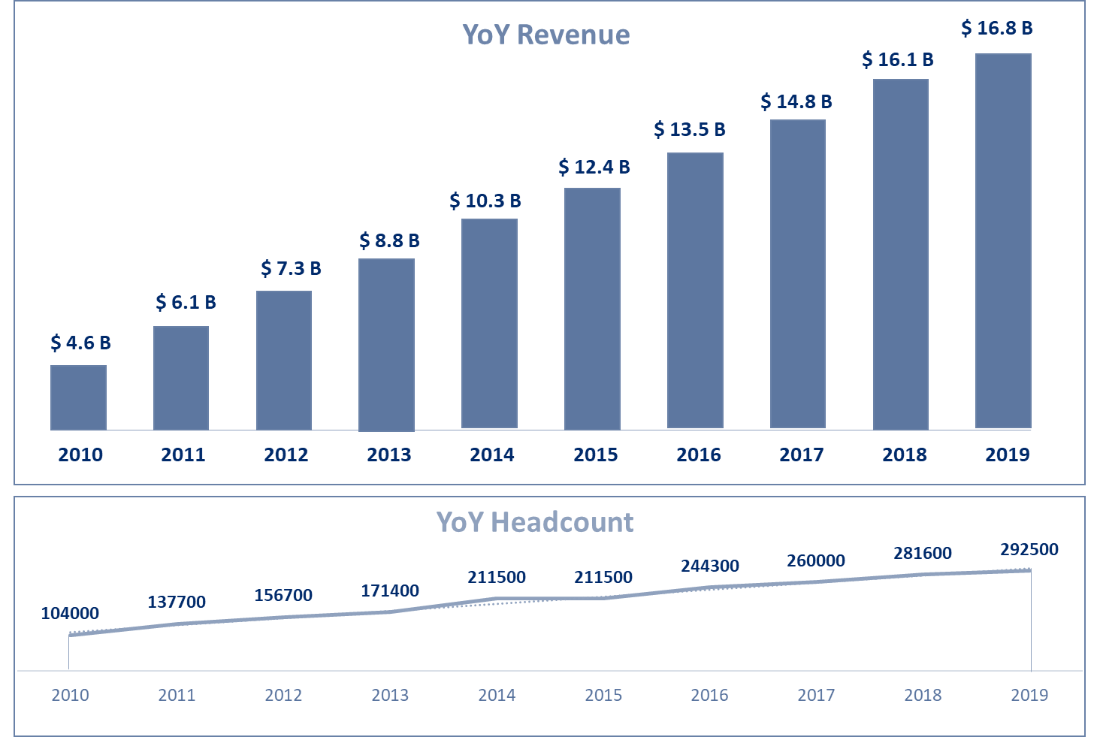
25+ YEARS OF COGNIZANT | BUILT TO PERFORM, ADAPT, ENDURE
1994
Foundation Year
26 Years of Operation
291.7K
Employees
100K
Women Employees
350+
Clients Globally
>95% Client Retention Rate in last 3 years
41%
Digital Revenue Share
of total Q1’20 revenue
90%
Growth in Digital Revenue in 2019 compared to 2018
290+
Global Offices
37 Countries of Operation
Our Focus for the future of Digital
12
Fortune’s
Most Admired Companies 2019;
11 Years in a Row
461
Forbes
Best Employers for Diversity 2019
63
Forbes
Top 100 Digital Companies
2019
2019 numbers
Digital Engineering
90% Y-o-Y growth
AI & Analytics
Achieved $1.7 BN
IOT & Connected Systems
$0.3 BN
Cloud & SaaS
2X investments Y-o-Y

Slide 5




















GLOBAL PRODUCT ENGINEERING WITH SCALE AND AGILITY
70+ | 6,500 | 1,150 | 20,000 | 1,650 | 15,000 | 500 +
Offices Globally | Experience Designers | Marketing Consultants | Digital Engineers | Commerce Specialists | Data Engineers | SAP Hybris Consultants
KEY DIGITAL ACQUISITIONS
London
Amsterdam
Toronto, ON
Paris
Romania
Chicago
New York
Philadelphia
Madrid
Shanghai
GLOBAL COMMUNITIES & TALENT
San Francisco
Dallas
Osaka
Mexico
Tampa
Pune
14 Core Communities of Talent
Hyderabad
Manila
Costa Rica
Chennai
PARTNERSHIPS
Brazil
Melbourne
Argentina
AWARDS

Slide 6
Our Footprint in Restaurant Space

Slide 7
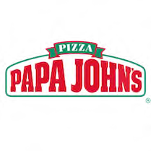









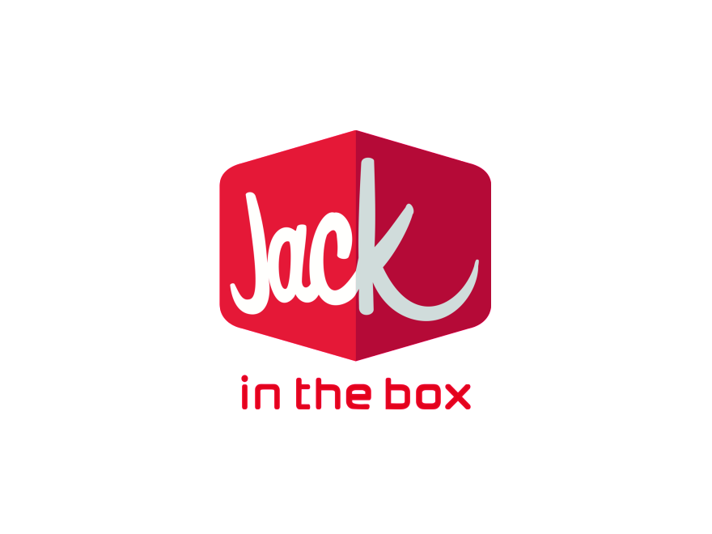


ACROSS THE VALUE CHAIN
IN-RESTAURANT
WEB
OMNICHANNEL COMMERCE
APP
INNOVATION

Slide 8

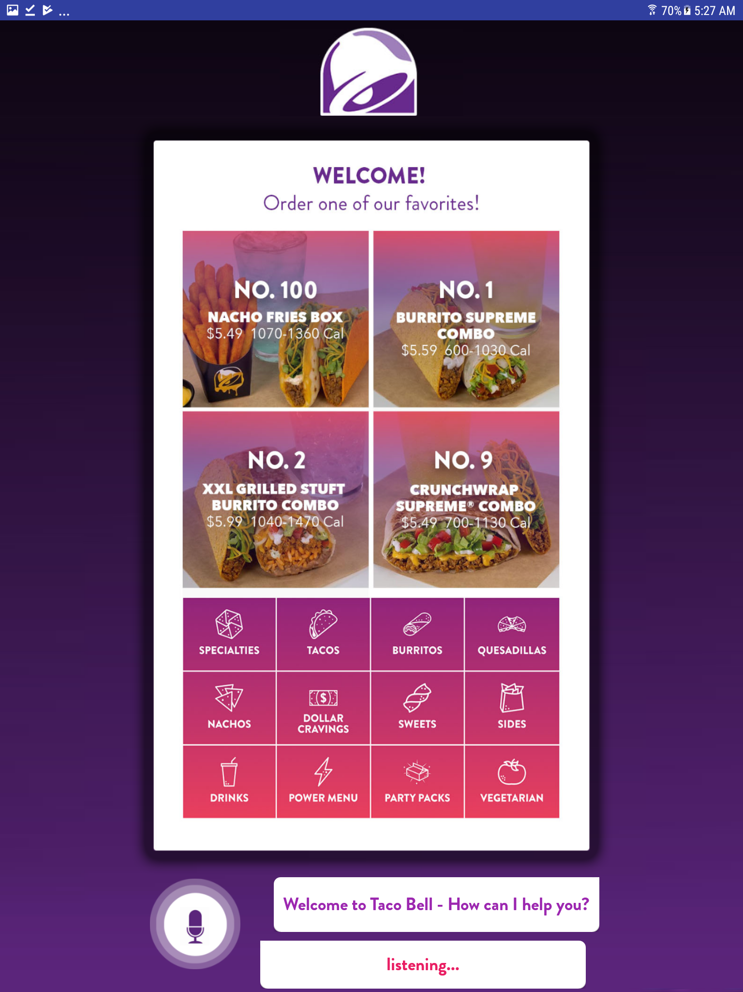
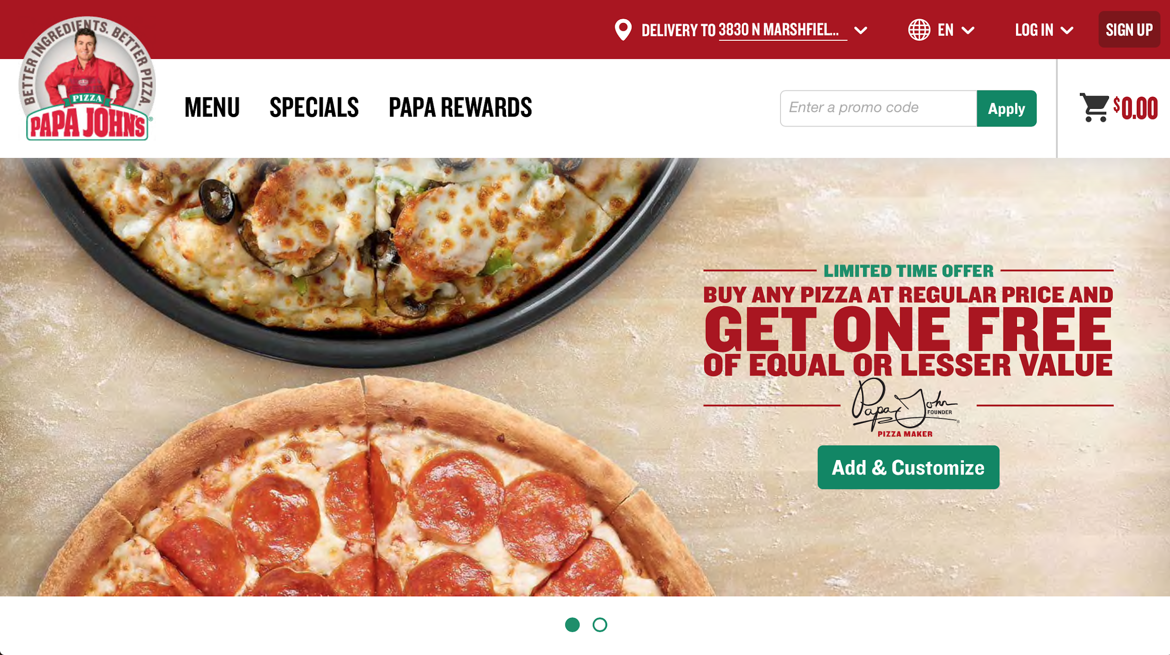

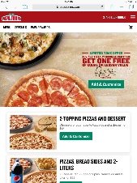

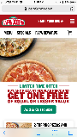
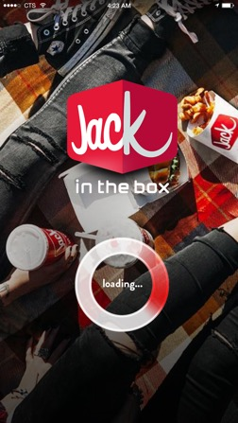
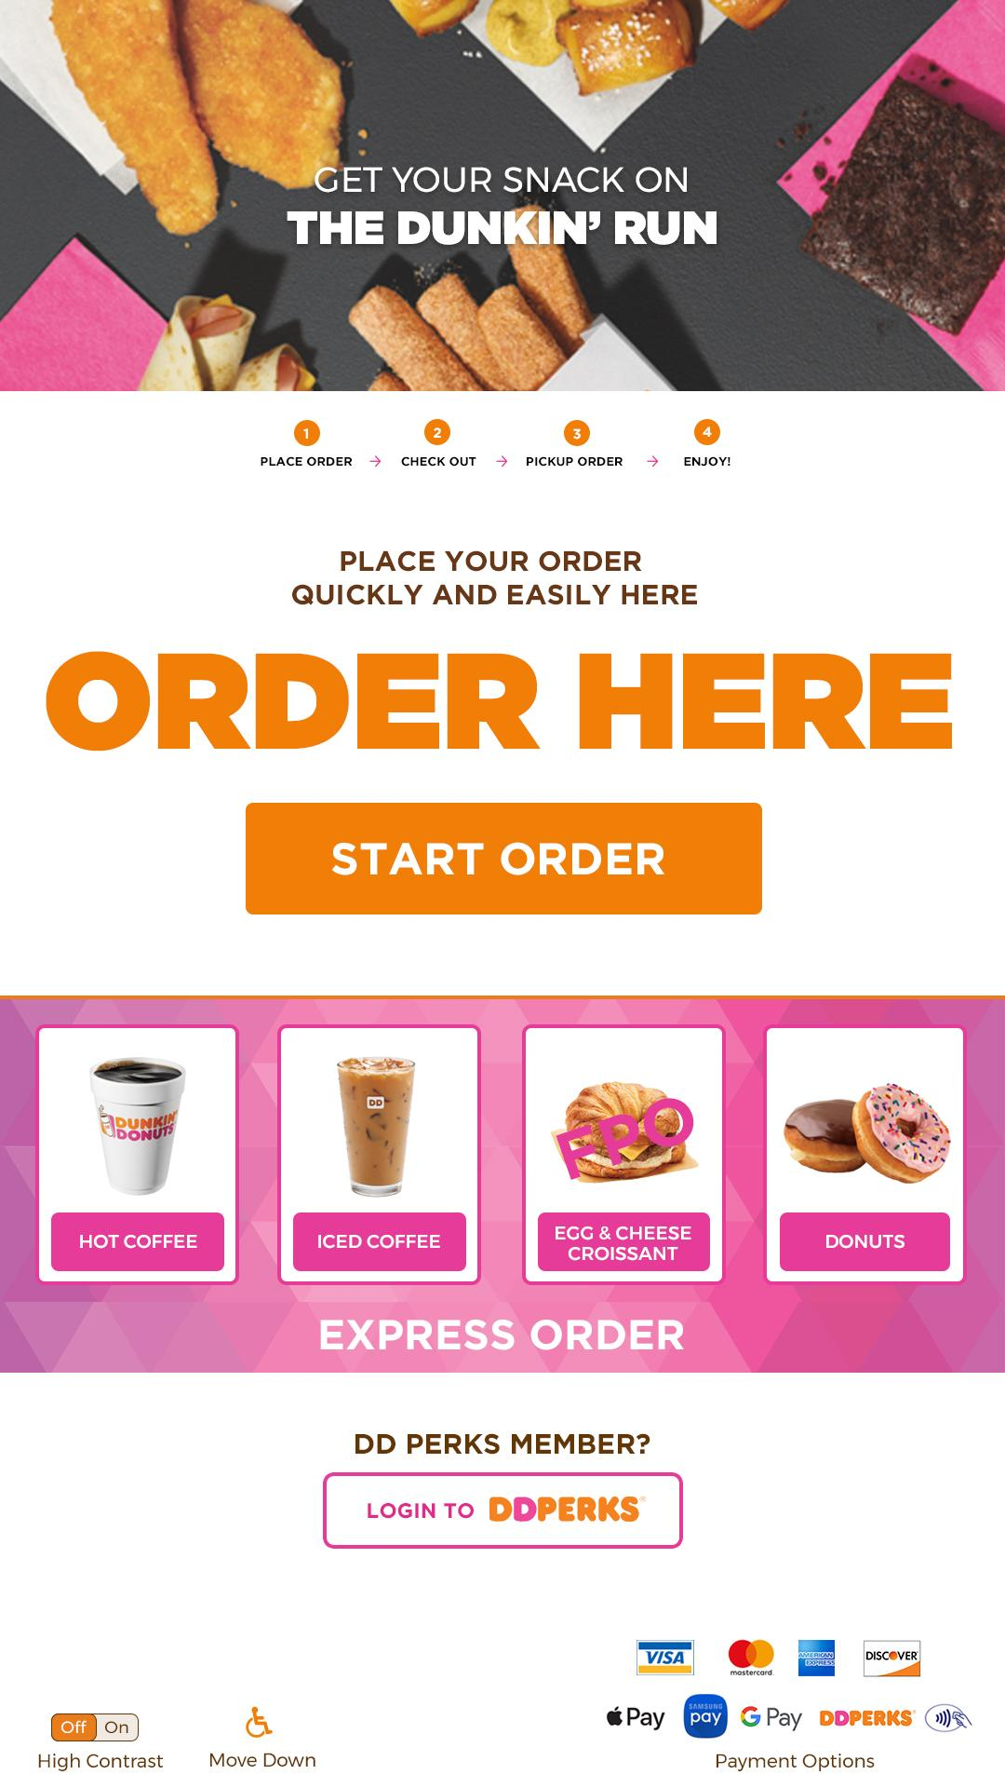
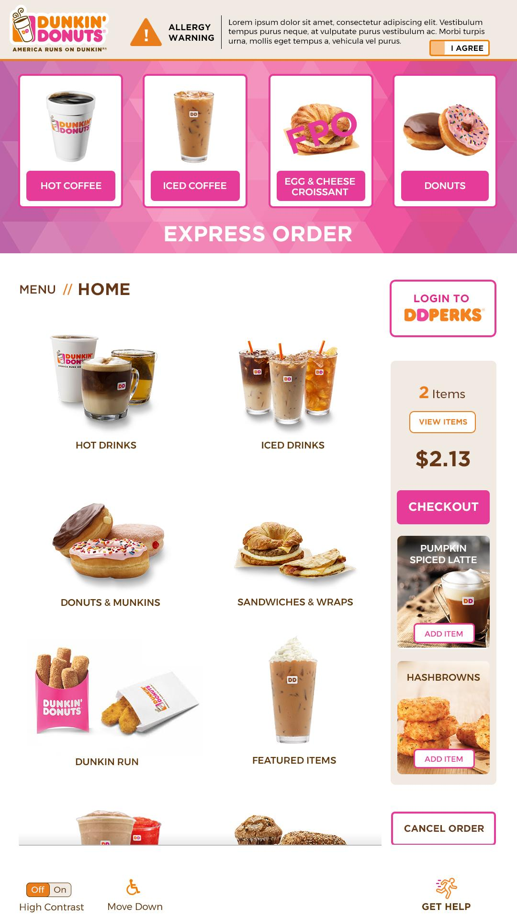
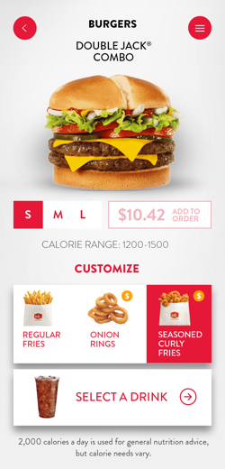
DELIVERING INDUSTRY LEADING PRODUCTS
PAPAJOHNS.COM
eCommerce Development
Store Systems Development
UX Strategy
Cloud Native Transformation
VOICE ORDERING
Conversational AI Ordering Platform deployable via app/web/kiosk/drive-thru
Visual, Audio, and Voice Interaction Design
JACK IN THE BOX APP
Digital Strategy
Mobile App Design
Mobile App Development
Mobile App Testing
DUNKIN’ DONUTS KIOSK
Kiosk UX, Visual Design, and CX

Slide 9
McDonald’s & Cognizant

Slide 10
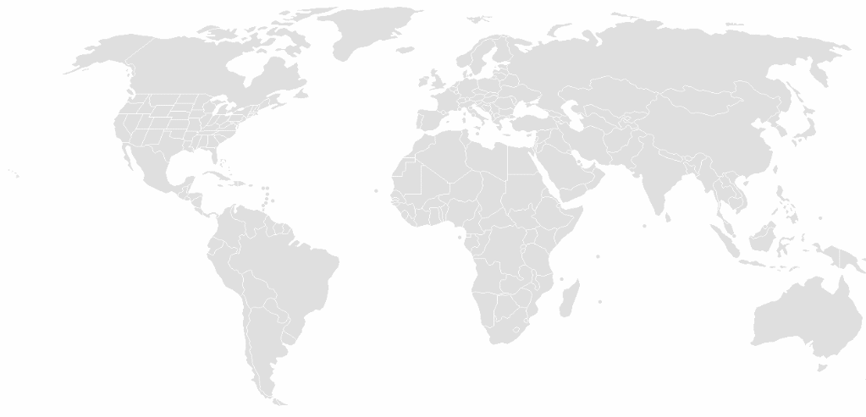




OUR GLOBAL PARTNERSHIP WITH MCDONALD’S
AM/AE AD /QE&A Consulting Core Modernization Infra Intelligent Automation
US, Canada
Months of Steady State
Associates
Continuous Service Improvements
UK, Ireland, Germany
34+
Saudi Arabia
6
6
450+
24*7
India
Mexico
Australia
Months of Transition & Stabilization
Delivery Locations
Managed Service
Cognizant Delivery Location
McDonald’s Location
Finance
Master Data
Management
US Business
Enterprise Collaboration
& Communication platforms
HR
Corporate & Legal
Functions
Payroll
Supply Chain
Management
Infrastructure
Our Commitment - Transform McDonald’s through Technology, Industry knowledge and Standardization
Land Safe
Run Better
Run Different
Most appreciated Transition | ITSM | OCM
Zero Maintenance Framework | ITPA
QA Automation | Servicenow adoption
Business SLA | Agile | DevOps | Legacy Modernization | Cloud Transformation | IPA

Slide 11










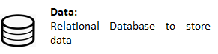











OVERVIEW OF MAJOR DIGITAL PROGRAMS IN MCDONALD'S
Sales Modernization Program
(In Production)
MHQ – Day Pass
(In Production)
Franchisee Management
(Ongoing)
Global Network Architecture
(OnGoing)
Sales Modernization Program
(In Production)
Re-writing a 40 year old MF system responsible for collecting, consolidating and reporting McDonald’s world-wide sales into a mobile compatible single window, highly responsive resilient and scalable cloud based digital ecosystem called: McDonald’s Global Sales
Healthy Day Check Mobile solution asking staff (employees, contractors, vendors, suppliers and visitors) a series of questions before coming to the office in order to determine if they are at risk of currently being infected with Covid-19
Part of MF Retirement Initiative, this involves re-writing of the application for Franchise Management into a cloud-native microservices based Azure solution leveraging Agile DevOps thereby leading to faster deployment & time-to-market
Build an Integrated Platform or Portal to provide visibility and enable quick decision making for global initiatives executed by McDonald's Network Architecture Team. Include Data Capture, Reporting and Exception Workflows
API Gateway
Elastic Container
Service
AWS
Lambda
Data:
Relational Database to store data
Cloud:
Cloud platform to deploy application
ElastiCache
Redis
CloudFront
Simple Storage
Service (S3)

Slide 12




KEY AREAS OF FOCUS
Where can we help?
Creating dedicated
Product Support teams
Agility to move to new markets & Ability to quickly
replicate and scale for global launches
Assuring Quality of the work delivered, by achieving Predictability, Dependability and Repetitiveness
Define a model for new products to scale and launch globally
Repeatable approach with clear KPIs to enable quality in the ongoing product development & support

Slide 13
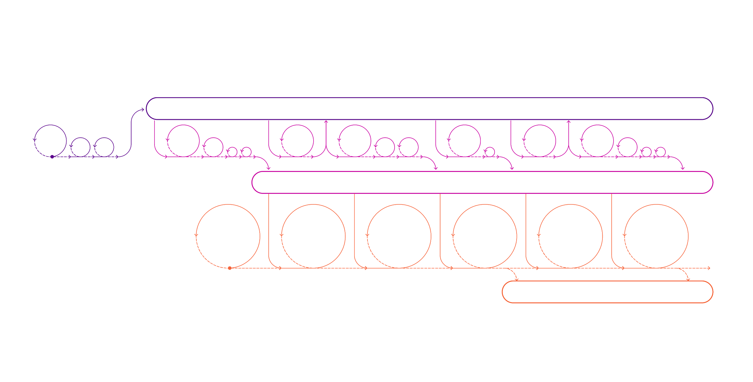
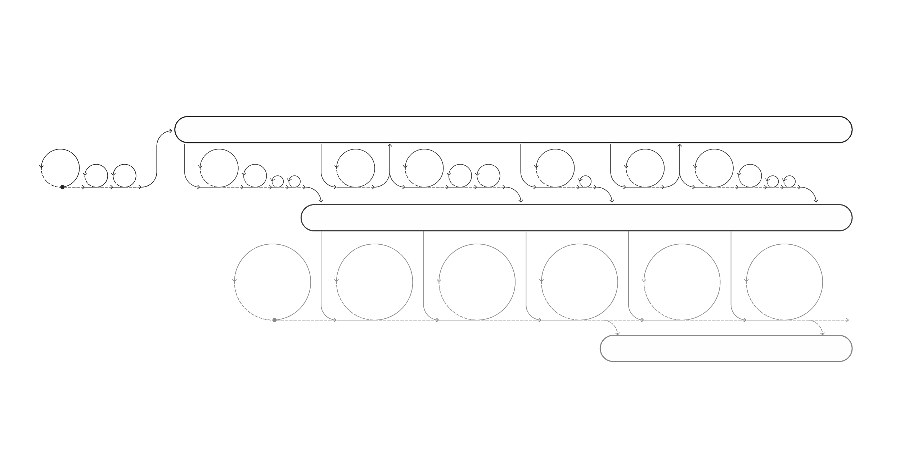

CONTINUOUS VALUE DELIVERY
DISCOVERY BACKLOG OPPORTUNITIES / PROBLEMS TO SOLVE / HYPOTHESIS / DESIGN
DISCOVERY SPRINT
DISCOVERY BACKLOG PRODUCTION RELEASES
SPRINT
#D0
SPRINT
#D1S
SPRINT
#D2S
SPRINT #D32
SPRINT #D4S
SPRINT
#D5S
Dedicated quality engineering teams
support product +
ongoing roadmap
MINIMAL VIABLE PRODUCT
AUTOMATED & MANUAL QA
Ensure high velocity updates for crucial fixes
Maximize automation coverage

Slide 14
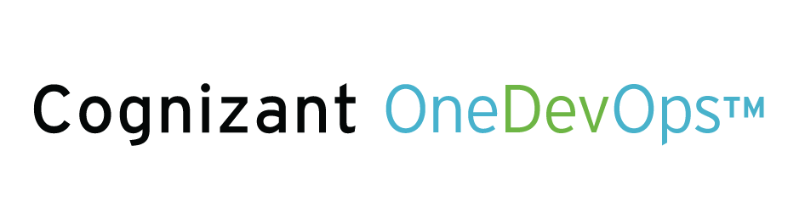
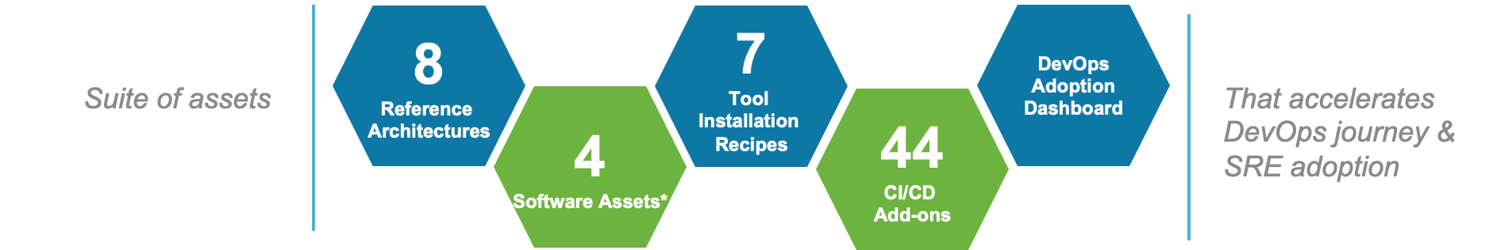
SRE ADOPTION THROUGH ONEDEVOPS PLATFORM
Balancing speed & quality for global scale rollouts, localizations.
Site Risk traceability
Reliability Validation
Biz process complexity analysis
Downstream/upstream flow analysis for upcoming releases
Implementation impact analysis
Analyze DevOps practices
Re evaluate site risk for releases
Review performance due to global scale rollout impacts
Perform localizations and validate them leveraging automation
Conduct capacity baseline and analysis from test results
Adopt DevOps practices
1. Localization & Rollout Impact Analysis
2. Localizations Validations
Review SLOs
Capacity Planning
Capacity Prediction
Operational Readiness
RCA and Tuning feedback to app owners and home markets
Provide feedback to planning activities
Rate risks and conduct Impact analysis against SLOs
4. Live Operation phase
3. Production Rollout phase
Measuring capacity plans, KPIs, quality and speed metrics at global scale
Configuring system alert KPIs to predict and resolve high priority incidents and problems
Integration feasibility resolutions into run-book automation
Emergency Response
Smart Health Check

Slide 15
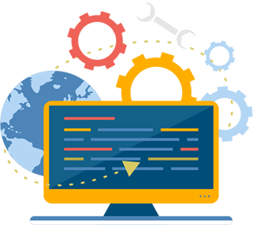







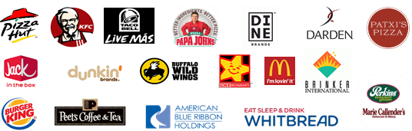




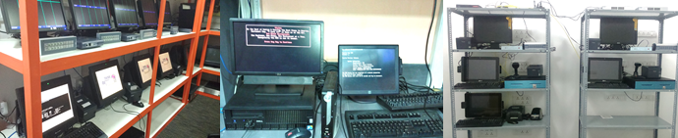









POWERED BY INDUSTRY CONTEXT – RESTAURANT TESTING CAPABILITIES
2000+
Reusable test scenarios
Re-usable Mobile, POS and Back Office Automation Framework
18+ Years
EXPERIENCE IN SERVICING
ASSETS
Restaurant Knowledge Portal
DOMAIN KNOWLEDGE
PEOPLE
Dedicated team with mix of strong restaurant domain and technical skillset
Quick Service/ Fast Food
Fine Dining
Casual Dining
Café
UTILIZING
TOOL PLATFORMS
PRODUCT UNDERSTANDING
Leading Restaurants across North America, South America, Australia, Singapore, Thailand, Philippine, Japan, Malaysia, UK
Extensive experience with Java – Selenium, HP UFT, Sikuli, CITS (Cognizant in-house) eggPlant, SeeTest Automation, Groovy, HP Loadrunner..
Key products experience including
FOH: Micros, NCR Aloha, Xpient, Squirrel, Simphony
BOH: Altametrics, RedPraire, CrunchTime etc.
Above Store: Microsoft GP, AS 400
SERVICE SPECTRUM
OFFSHORE POS TEST LABS (On Premise) – for End to End Testing
Multi Channel and Multi Brands Support
NFT
CX Testing
Interface / Integration Testing
UAT Support
Migration Testing
Services / Middleware Testing
Mobile / Handheld Testing
Test Automation
Aloha POS & CrunchTime Capability
Testing Touchpoints

Slide 16









RELEASE CERTIFICATION APPROACH
Feature POD
Release Certification POD
Production Launch
Product Owner
Entry Criteria
Quality Engineers
Exit Criteria
Scrum Master
Performance
Engineers
Accessibility
Security
FSDs
Completed Feature level test cases
All test logs
Open defect details
Completed Feature level Automation Scripts
Met the “Definition of Done”
Following deliverables will be complete:
SIT and E2E Test Cases and Logs
Regression Test Logs
Performance, Security, Accessibility and CX Reports
Test Summary Report
Sign off on all open defects from Business
QA sign off
Feature Test Cases during sprints
QEs
Automated Test Scripts after each sprint
CX
Activities:
System Integration Testing
End to End Business process Assurance
Continuous Regression validation (automated)
Non-Functional testing:
Performance
Security
Accessibility
Customer Experience
UAT Support
Enhance Test Cases for SIT and E2E
Enhance automated scripts for Regression
Test Cases
Test Execution Logs/ Defects
Metrics & Reports
NFT Recommendations
Tools/ Differentiators
CIQD
LEAP
Quality Insight BOTs
NFT Assure
Release Certification KPIs
~80%
Automation Coverage across Layers
<1%
Critical defect leakage to production
30-60%
Reduction in Test Cycle Time

Slide 17





Price Sensitivity Loyalty customers trust the brand does less price comparison
Lifetime Value Loyalty customers spend 5-10% more than non-members
Retention Typically 50%-70% revenue comes from repeat visits
Referrals 20-50% of purchasing decisions are influenced by referrals
If done right Loyalty can be a game changer
How QSR’s are benefitting from loyalty?
© COGNIZANT 2020

Slide 18












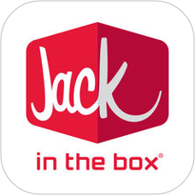






COGNIZANT LOYALTY EXPERIENCES

Slide 19
Thank You!

Slide 20
Appendix

Slide 21
Client Stories

Slide 22
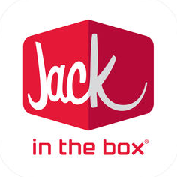

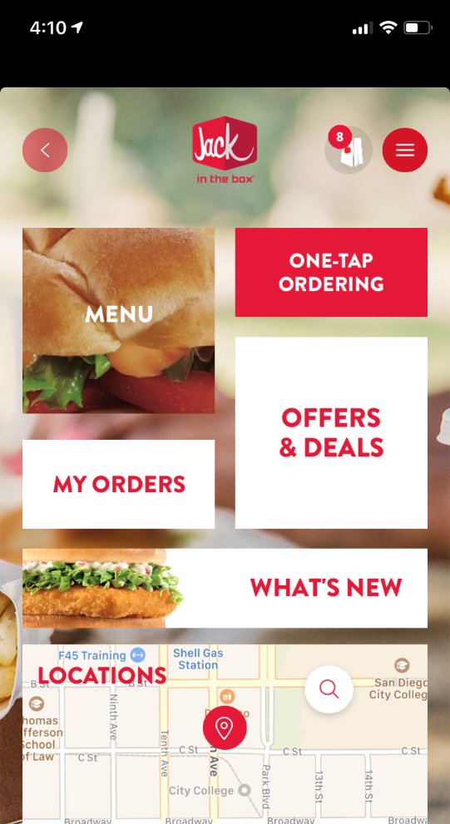
TRANSFORMING CUSTOMER EXPERIENCE
End-to-end experience transformation, including:
strategy: op model, service design, technology architecture and roadmap
pwa: built like for like pwa web ordering app in record four sprints
unified profiles: unified the existing eclub user base with mobile app subscribers, cross channel promotion led to 20% increase in revenue
marketing: relaunching brand site with web ordering
analytics: built integrations with existing bi platform and leveraging ai to drive personalized promotions based on user ordering patterns
mobile: ​introduced range of features based on the feedback from guests, franchise owners, guest services and store operations
CHECK SIZE INCREASE | YOY REVENUE GROWTH | TCO REDUCTION
20% | 200% | 50%

Slide 23
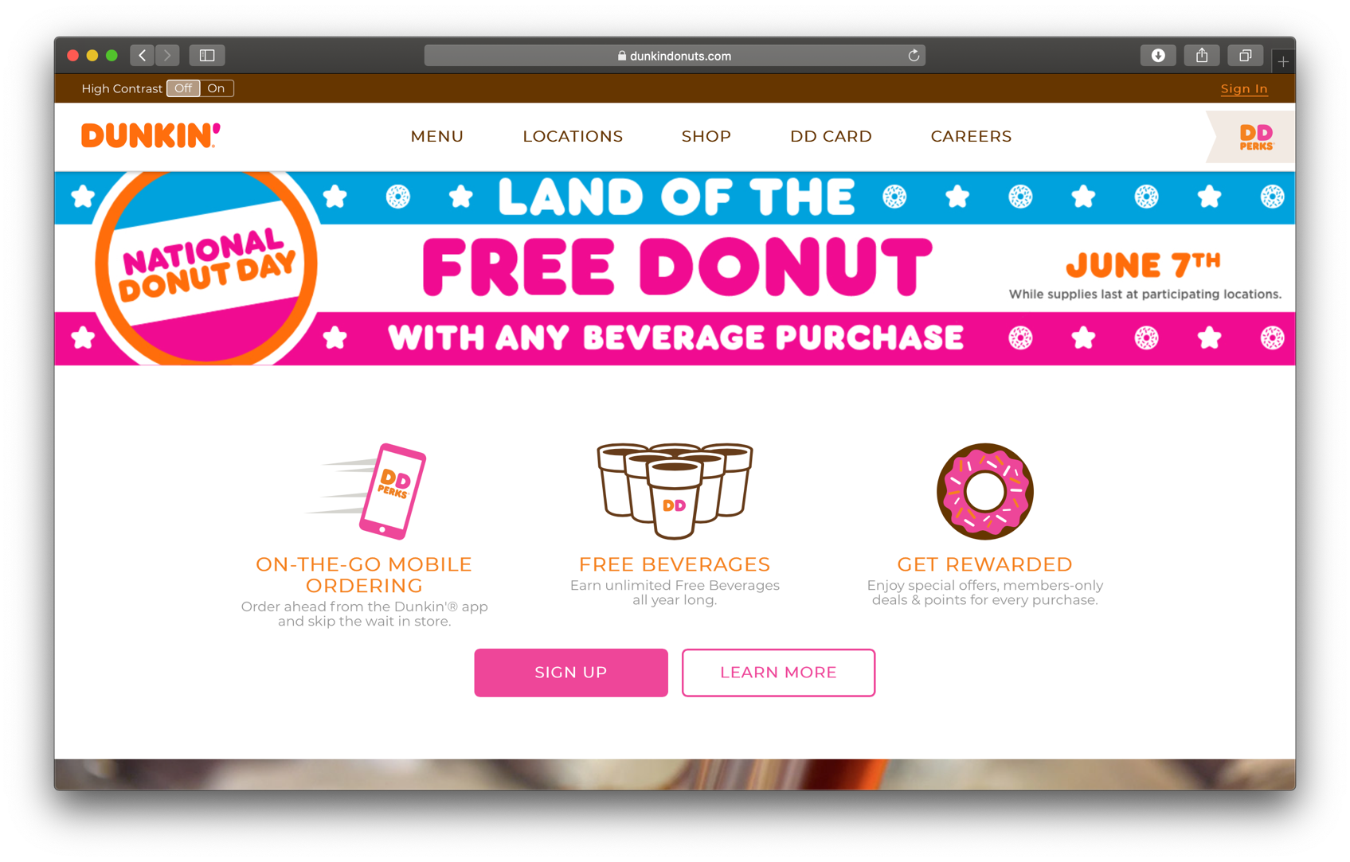



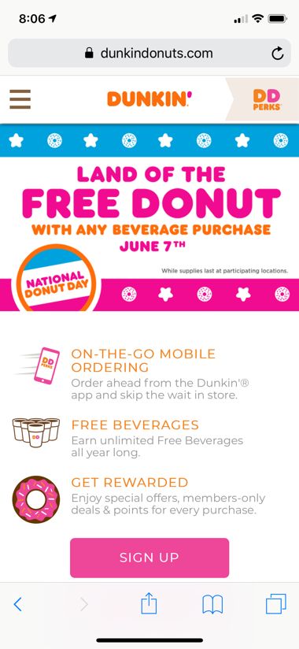
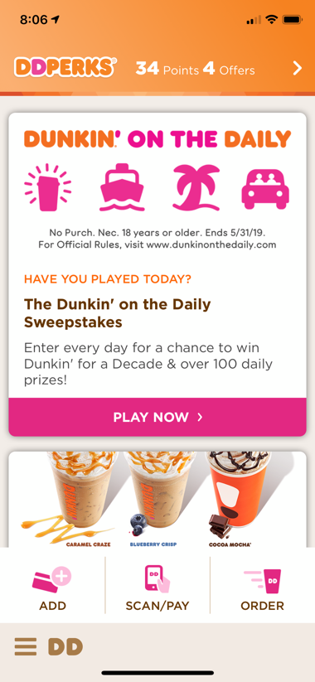
DIGITAL STRATEGY & TRANSFORMATION
E2E provider for Strategy, Design, Marketing, App/CMS/eComm Development, Maintenance and Support
Weekly marketing updates from design to deploy
Rebrand design for app and web
Redesign for new Loyalty program
Updates for ADA, Nutrition, and other compliance needs
Single integration point for all Dunkin’ teams
CLIENT TEAMS SUPPORTED | PRODUCTION ON-TIME
6+ | 100%

Slide 24
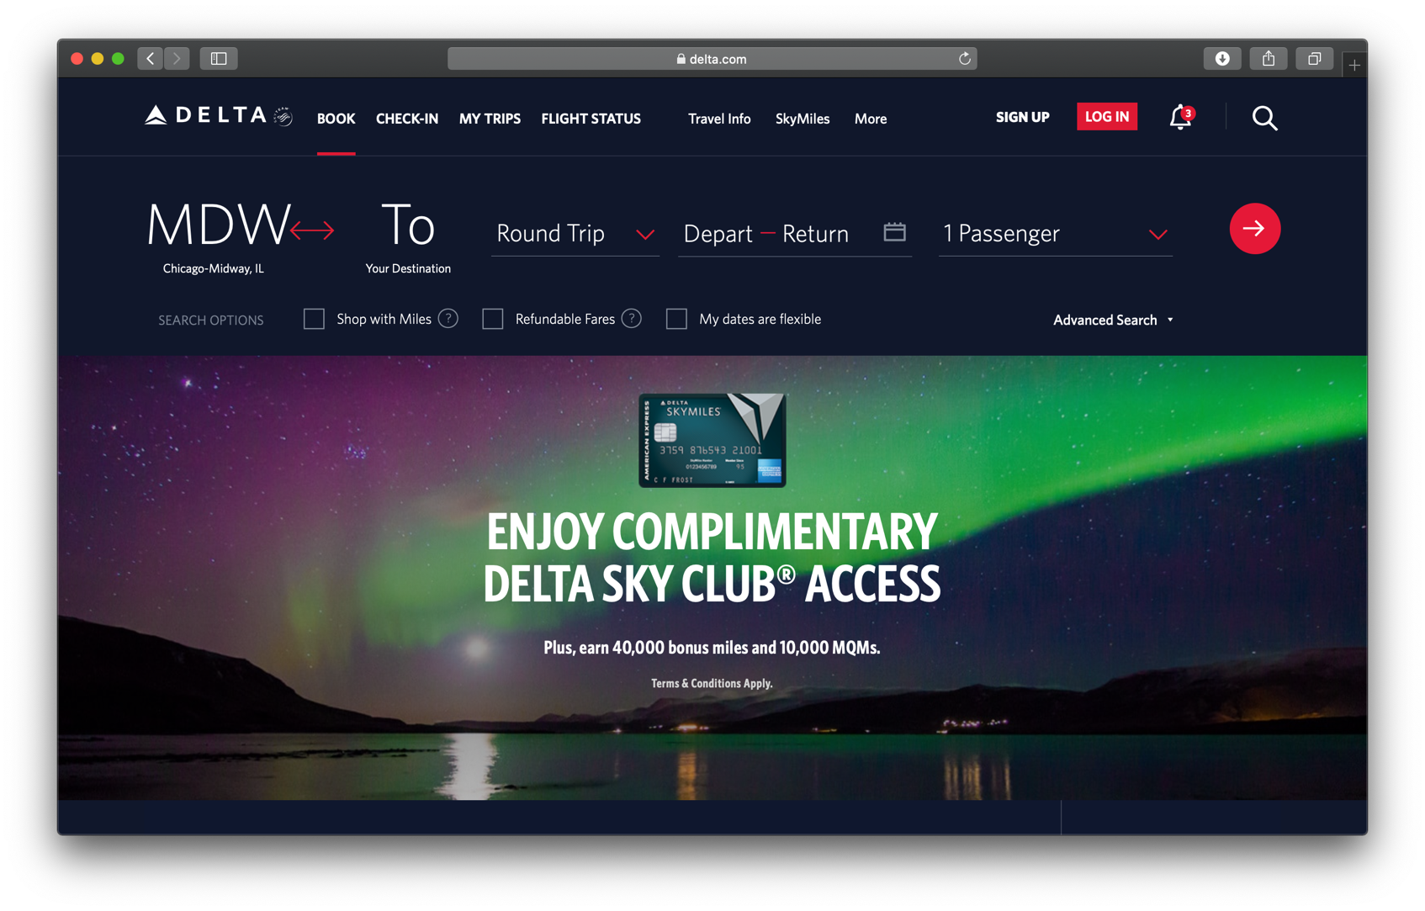

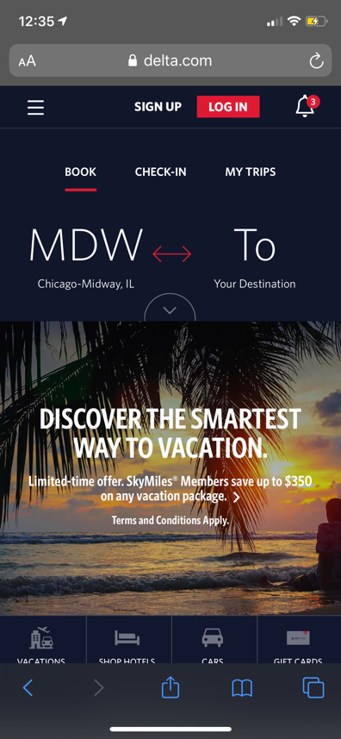
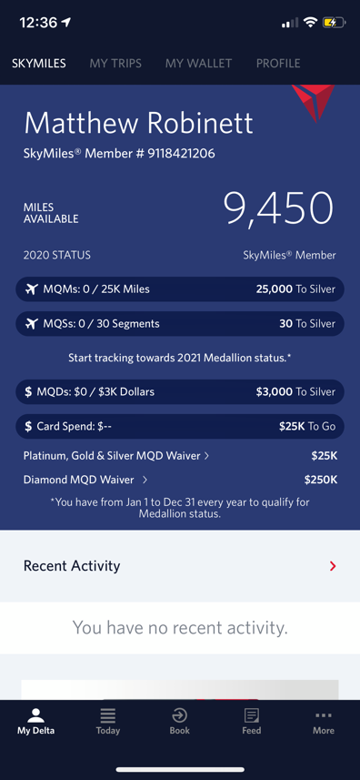
LOYALTY APP & WEB DEVELOPMENT
Digital engineering support and enhancement using DevOps for delta.com and the FlyDelta android app
Supporting all booking, account management, loyalty delivery, earn/burn capabilities, etc.
Delivering innovation in providing a highly contextual, personalized, gamified experience
SONARQUBE QUALITY SCORE | PRODUCTION ON-TIME
A+ | 100%
Notes:
Jay I
Helped them Evolve loyalty across app and web for last 3 years. All innovations to booking, account, earn/burn has been done by Cognizant. Highly contextual based on whether you have flight or not, highly adaptive/personalized experience.

Slide 25
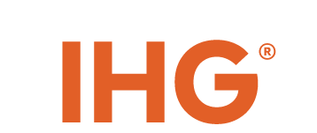

LOYALTY APP SUPPORT & ENHANCEMENT
Redesign of Reservation Confirmation Flow - Credit Card, Alternate Payments, Alipay, WeChat, Paypal
Major GRS re-pointing migration & integration development
Booking Flow redesign to enhance Guest Experience & drive upsell & cross sell
Continuous enhancement to IHG Rewards Club member experience based on program evolution & changes
CODE ACCEPTANCE | SPRINT STORY DELIVERY
90%+ | 108%
Notes:
Jay I
Takeover, massive services replacements, redesign of checkout flow, focused on upsell, customer personalization work, implemented MDM and intelligence platform for highly contextualized and personalized experience.
Nearshore SAFE mobile application development POD;
Redesign of Reservation Confirmation Screen - Credit Card, Alternate Payments, Alipay, WeChat, Paypal
GRS Migration & Integration Support
Booking Flow redesign to enhance Guest Experience & drive upsell
Implemented Ensighten TMS to enable Adobe Analytics

Slide 26

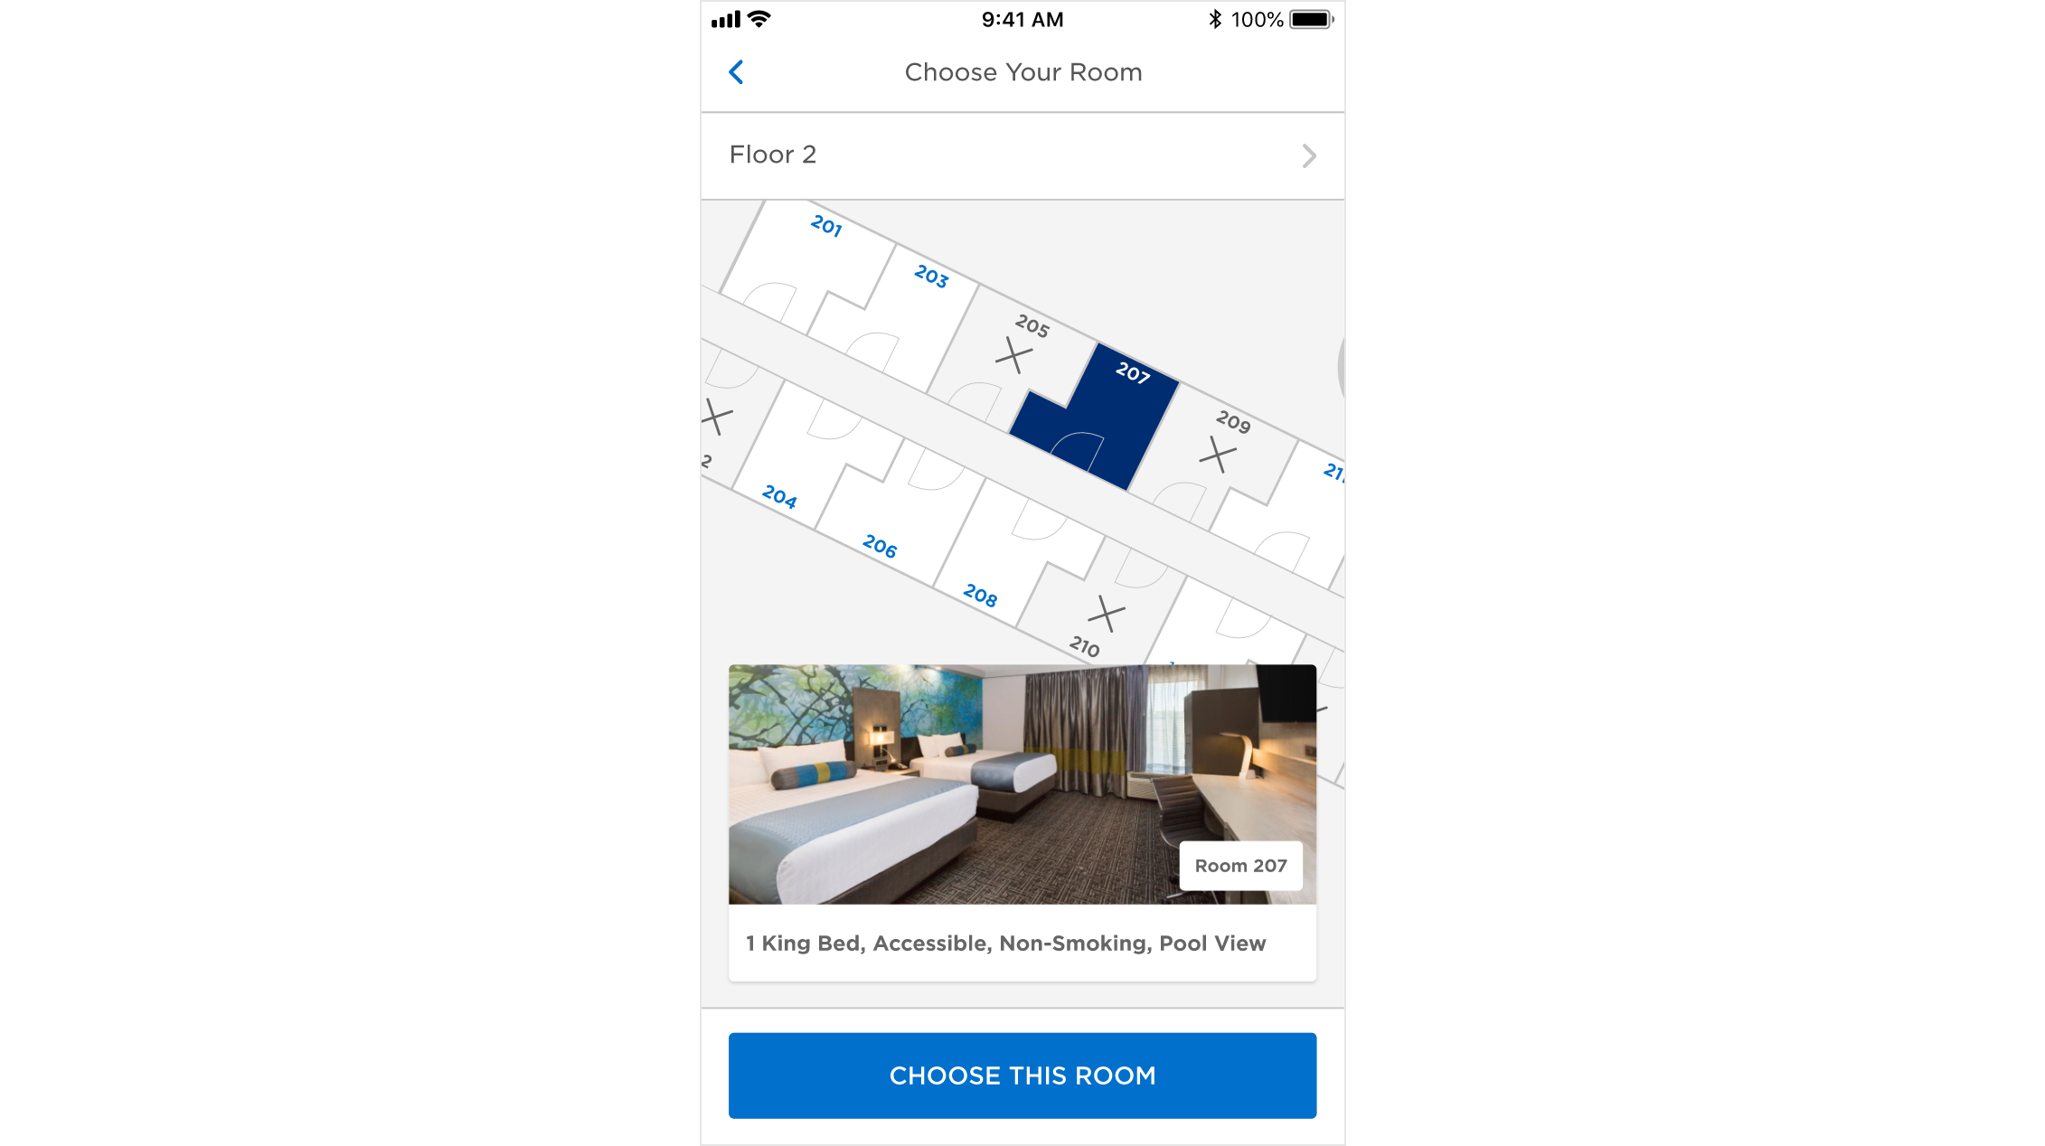

GROUND UP LOYALTY APP DEVELOPMENT
Complete redevelopment of the Wyndham Hotels mobile app in Swift & Kotlin
Implemented all loyalty features across account, tier-based features, earn, burn, gamification, etc.
Contextually driven experience based on data from booking and loyalty integrations
Personalization & NBO powered by Adobe Analytics & Target
Business driven content powered by AEM through content services, content fragments, and experience fragments
Highly complex project coordinating 8 App PODs, 2 Services PODs, Design, and 10+ external integrations
Global architecture with support for English & Spanish today and dozens more in the future
Notes:
Jay I- who led this team at Wyndham. Indirectly showcasing
Safe, Global

Slide 27

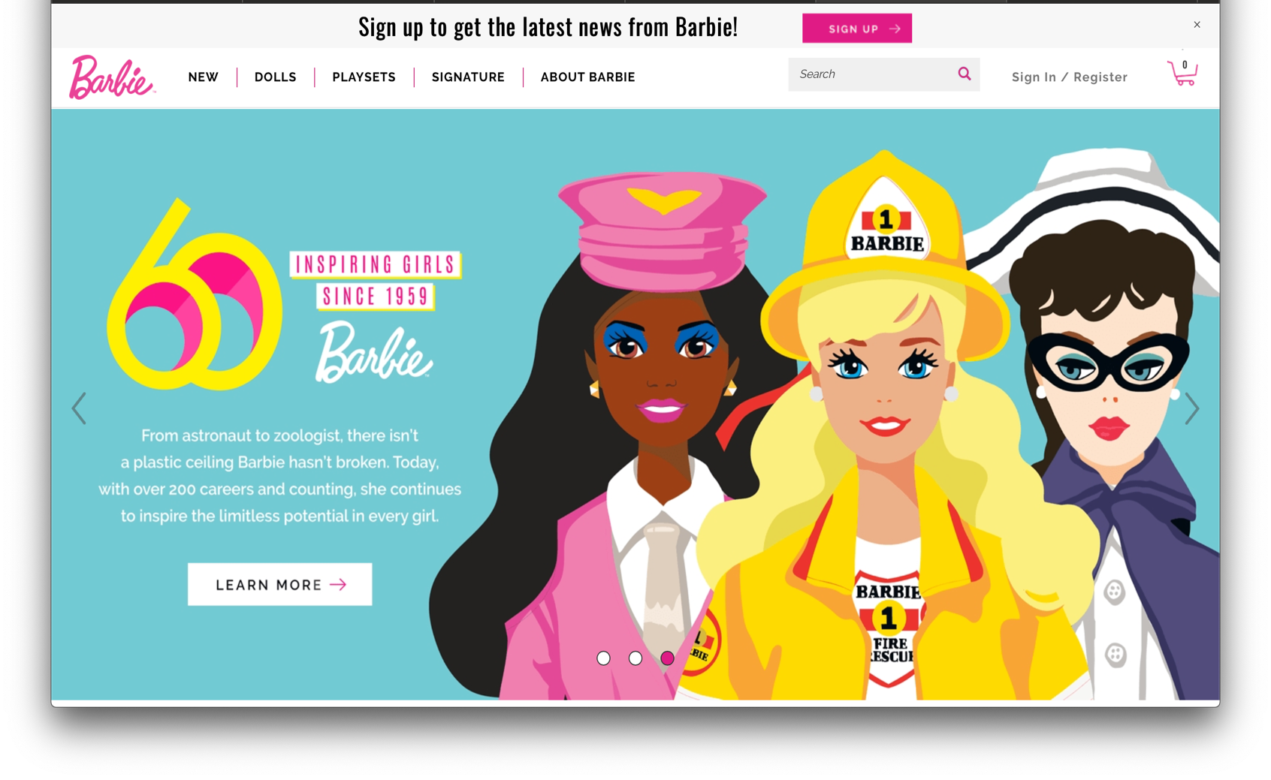

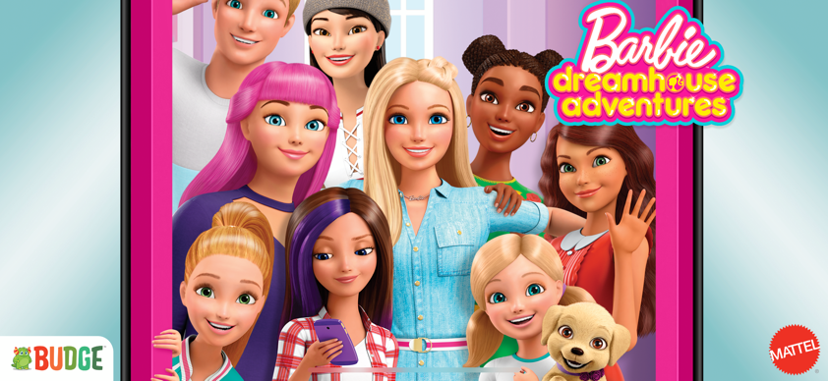
MULTI-BRAND EXPERIENCE PLATFORM
ADOBE MARKETING CLOUD
Using CMS + eCommerce to deploy consistent and personalized content experiences that deepen engagement and loyalty for dozens of Brands globally. Customer 360 + analytics to drive personalized marketing across every channel.
REVENUE GROWTH | CUSTOMER ENGAGEMENT
+25% | +20%

Slide 28
GLOBAL LARGEST RETAILER
Cognizant Solution
Customer Scenario
Cognizant designed and implemented Digital Engineering transformation strategy and roadmap
Led inception to realization of SOR Data Services integration platform to provide Finance and accounting information to other enterprise apps
Domain Driven Design approach to build Cloud Native Microservices to decouple existing SOR systems
Azure DevOps driven automated gating and release all way to production
Mainframe DB2 & IMS to Azure CosmosDB data migration to set stage for decommission legacy systems in future.
Embarking on a digital transformation journey by leveraging Cloud solutions and modern MicroServices architecture. Modernize System of Record - finance and accounting services portfolio to further speed up transformation, to streamline its business and continue investing in improved customer experiences.
Help drive growth, improve customers service and streamline processed by leveraging robotic process automation, machine learning, predictive analytics, artificial intelligence such as natural language understanding, and other digital technologies
Few pain points that the customer highlighted were:
Expense and hard to change SOR
Tightly coupled enterprise application
M&A app sprawl, decades old apps
Lack of Predictability and Low Quality
Technologies
Microservices, Spring Boot, Spring Cloud Data Flow, Azure Eventhub-Kafka, Azure CosmosDB/Mongo API, Azure DevOps, ServiceMesh.
Key Outcomes
Achieved Digital Engineering Led Transformation to achieve Rapid release, Azure adoption, On Demand automate delivery capability
Key metrics as below
2-4 weeks Concept to deploy cycle, reduced from 6 months
Cloud scale to serve 100+TB of data for all enterprise apps
Process 1+billion events per week
Enabled Better Predictability with increased Quality
© 2019 Cognizant

Slide 29

US AUTOPART, ADVICE &
ACCESSORY PROVIDER
Devops driven operational cost reduction and delivery
transformation.
Smart Environment: Automated Provisioning of Public Cloud resources using Jenkins pipeline jobs and Terraform templates
Build, Release, Deployment Automation: End to end automated pipeline leveraging ‘Build Once Deploy Anywhere’ technique
ServerLess Functions: Canary releases using API-Gateways
50%
Improvement in Time to Market
~3 Minutes
Environment Provisioning Time
Zero Manual Intervention
High-Velocity release cycles
30%
Productivity Increase

Slide 30
Enterprise DevOps Transformation
U.S. Based Leading Healthcare Provider
The client is the largest customer-owned health insurer in US and fourth largest with over 15 million members across 5 state. It offers group life, disability, and dental solutions, and a range of other individual solutions
Business Goal
Improve the ability to respond to end user demands by launching more features for enterprise applications accessed by Providers, Retail business, Customer Service and internal corporate applications
Business Ask
IT Organization to provide agility to support evolving business needs by improving release velocity
How?
DevOps led IT Transformation
To enable IT by automating delivery pipeline and providing On-Demand deployment capabilities for enterprise applications

Slide 31
DEVOPS TRANSFORMATION | ORGANIZATION, CULTURE, PROCESS
Cultural Transformation Solution Levers
People & Process
Organizational Change Management | Cross Skilling of workforce | Process changes | Budgetary Changes | Evangelization
Improved Developer Productivity
Adoption of the Agile and OWF methodology to support continuous pipeline of work.
Adoption of Jira and Portfolio for JIRA for Agile/Optimized Waterfall Roadmap planning and provide Team & Project visibility.
Integrated Process into DevOps Automation Framework to minimize manual intervention in Requirement Lifecycle (Requirement to Deployment) .
Team Restructuring
Created new “Business-Centric” Roles and aligned staff into Portfolio/Product Teams.
Streamlined Communication
Communication pattern changed from ad – hoc to daily standup meetings
Change Enablement
Activation office Focused enablement of People, Process and Technology to support future state New DevOps Tooling Framework New Tools introduce and existing tools restructured, framework was approved for rollout across enterprise Business Centric Roles Aligned staff to Portfolio/Product Team Awareness and Readiness Product Team were trained on the new processes and delivery model | Process and Tool coaches Worked with teams to provide ongoing coaching on new tools and process Audit Proofing Created solution templates for each technology and ensured that they address audit issues Communication Conducted multiple workshops, brown bags and training sessions
Role in Change Enablement
Client: Governance and Implementation – Client DevOps champion responsible for strategy and implementation working with stakeholders | Cognizant: Consulting and Implementation enablement – Enable cultural transformation through inputs on team design and support implementation of strategy

Slide 32
OUTCOMES OF DEVOPS TRANSFORMATION
Reduced Build and Deploy Time | Reduced time to onboard applications to CI | Improved Code Coverage | Improved Test Automation Coverage | Improved Developer Productivity | Reduced time for deployment to Higher events | Improved Ability to release new features
120 Mins → 20 Mins | 7 Days → < 2 Hours | Random → 50% | <20% → 50% | 34 → 79 Story Points / Sprint | 3 – 4 Days → <1 Day | 6 → 12 Features / Release
What it meant to Business
6 Months → 4-6 Weeks
Reduced Concept to Deploy Time
7200 Person Hours / year
Addition to Developer Capacity
68 → 126 Features / Quarter
Improved Release Velocity
DevOps Transformation Foundation
DevOps Transformation Adoption
Assessment
Proof of Concept
Framework implemented with two critical Biz Applications
DevOps solution for Technology Based Apps
Standard solution templates created for applications with unique technology stacks. Examples include PEGA, COBOL, Windows etc.
Included more than 500 applications.
Team re-alignment and onboarding. Issues, Code and other artifacts were loaded into the new tool stack
CI/CD Pipelines created for each application and automated deployments were set up for each env.
Ongoing coaching on new tools and processes.
Base DevOps Framework Tooling evaluated and approved by IT Leadership
Framework implemented in AWS to expedite Transformation
ENGAGEMENT TIMELINES
Kick Off
March 2016
Dec 2016
Rest of 2017
Jan 2016
End of 2016

Slide 33
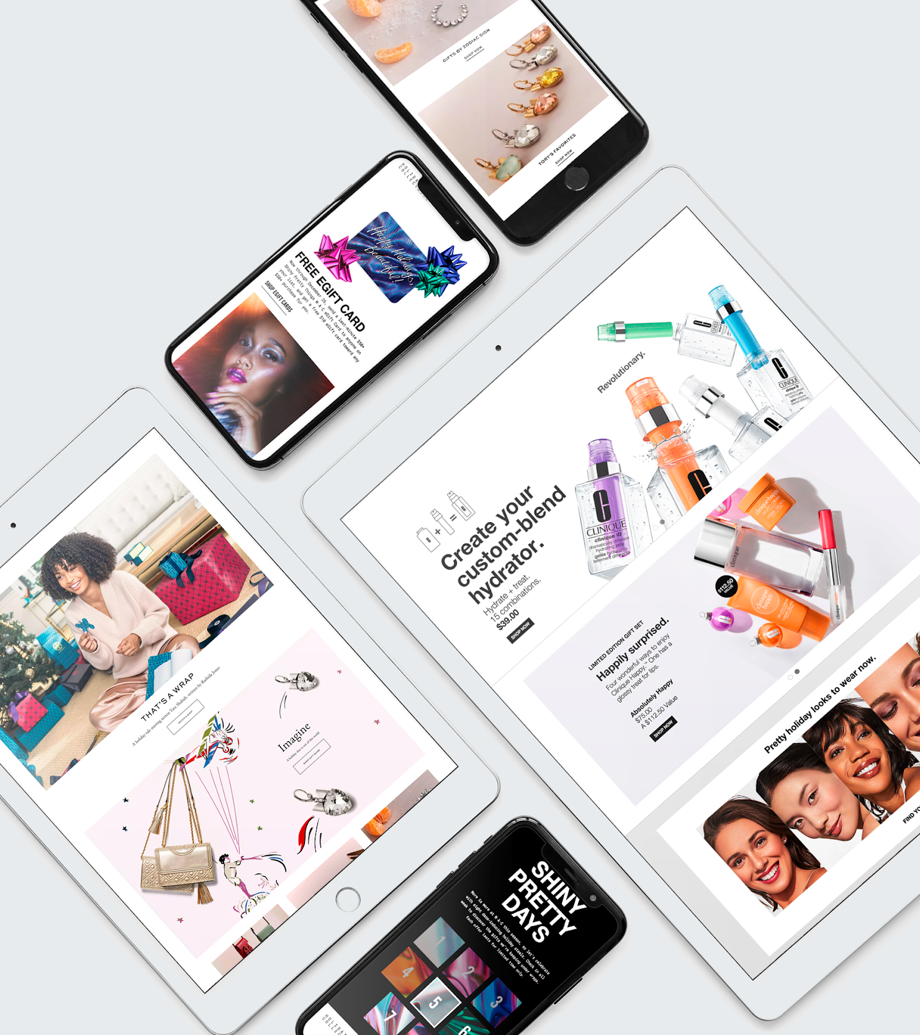
LARGE FRAGRANCE &
COSMETICS COMPANY
Successful digital partnership of 20 years.
SNAPSHOT
Global eCommerce sites across all Estée brands
eCommerce sites in 40+ countries
500+ eCommerce sites
$1B in eCommerce revenue in 2016
Dedicated team of 180 Softvisioners

Slide 34
LARGE FRAGRANCE &
COSMETICS COMPANY
Successful digital partnership of 20 years.
THE STORY
Softvision architected and built the an eCommerce platform that supports all Estee brands globally. We have a dedicated team of 180 people focused on the support an ongoing agile delivery.
Unified teams, assembled into communities, secured stability and growth to existing team and deployed a Romanian extension leveraging Guilds and the Pod model.
Softvision provided a path towards localizing the eCom sites for more than 20 of their subsidiary brands across 40 geographies and languages, on an aggressive timeline.
Softvision improved engineering and QA practices, added scalability and is currently modernizing the underlying digital platform tech.
Estee Lauder surpassed $2B in revenue via the e-Commerce platform built by Softvision… and the evolution continues

Slide 35
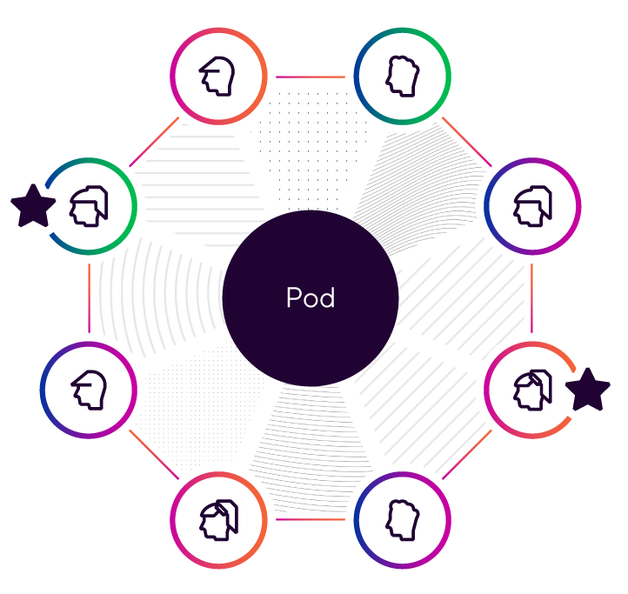
LARGE FRAGRANCE &
COSMETICS COMPANY
EVOLUTION OF TEAM & DEVELOPMENT STRUCTURE
Before - Skillset grouped
After- Pod Based, aligned by Value Stream
Waterfall evolving towards agile
Product Teams
Design teams
Front End Teams
Back End Teams
Pod
Pod
Pod
Pod
Pod
Pod
 | Branding |  | Product Discovery |  | Account |  | Offers |  | Checkout |  | Payment
# of Pods | 1 |  | 2 |  | 1 |  | 1 |  | 2 |  | 1
 | Comms |  | Store Locator |  | Search |  | DevOps |  | Prod Cat |  | Foundations
# of Pods | 1 |  | 1 |  | 1 |  | 1 |  | 1 |  | 2
Notes:
Implementation Manager across Value Streams

Slide 36
LARGE FRAGRANCE &
COSMETICS COMPANY
EVOLUTION OF SUCCESS
Before - Goal Based
Measurement
After- Our Maturity Model: KPI Dimensions
Meeting Launch timelines
Limited mechanical issues for launches
Budget and fixed scope related
Limited project based goals
Not tied to overall business success
30%
40%
30%
SPEED
QUALITY
PRODUCT IMPACT
Productivity measured by items delivered within a Sprint
Measures the degree to which product development addresses impact to objectives
Delivering business outcomes that drive success
Number of story points completed / sprint / pod members
Coverage percentage / completed feature for automated tests
Uptime of feature on the QA env. / month
eCommerce Revenue
Conversion rate
Basket size
Notes:
Implementation Manager across Value Streams

Slide 37
Thank You!

